Slide 1
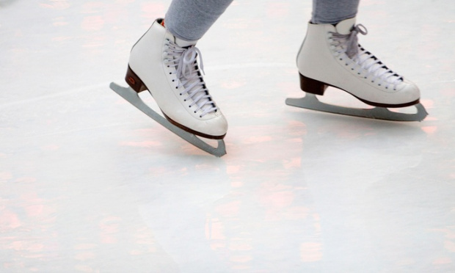
Website Content
www.oasiscentrearena.com

Slide 2
1. Homepage
- Slideshow berisi On Going Promotion;
Promo “OCA Pass Annual Membership Card” only 300k // Discount 30% for entrance, 10% for OCAffeine, 10% for Merchandise, 5% for Skating Academy // Valid for 1 year // Kids to adults
Promo Buy 2 get 3 dengan menggunakan AEON Privilege Card // Everyday from 10am til 10pm // Valid until end of December 2017
Promo “Ladies Friendship” // Only for ladies // Discount 30% // Only for Monday // Start from 10am – 10pm
Promo “Employee Day” // Showing ID Card // Discount 30% // Only for Tuesday // Start from 10am – 10pm
Promo “Follow and Snap” // Follow akun IG OCA & Snapgram dengan # // Discount 30% // Only for Wednesday // Start from 10am – 10pm
Promo “Kids zaman NOW” // Pay 1 get 2 // Kids and adults // Only for Thursday // Start from 10am – 10pm

Slide 3
Upcoming Promo
Promo “Redeem your 1000 points and get 1 free voucher” (Go-Jek => soon)
Promo “End of Year” // December 18th 2017 – January 13th 2018 // IDR 75k @person // From Monday to Friday // Start from 10am – 10pm
Buy ticket from Groupun, Lazada, etc
Promo per-theme setiap bulan harus ada tema baru// maks 2 bulan sekali (Valentine, Imlek, HAN, etc)
Join with Skating Academy and get special rate at limited time! Arahkan ke OCA pass. Get 5% disc everytime you pay.

Slide 4
Calendar
3 days in a row: free lesson for 30 mins, show, best deal, information for enrollment skating academy
Promotion Reminder
Information about Skating Academy

Slide 5
Plan Your Visit!
Getting Here
1. Where is the location?
Oasis Centre Arena is located at the 1st floor of AEON Mall Jakarta Garden City.
2. How to reach OCA Ice Rink?
It would be able to reach by public transportation such as motorcycle, bus, train, busway and vehicle transportation directly to the AEON Jakarta Garden. Choose your transportation!
Get directions here!
By toll road = from Bandung, Karawang and Bekasi entry from toll JORR (Jakarta Outer Ring Road), exit to toll East Cakung/Cilincing. From Jakarta entry from toll Cawang, go straight to toll JORR, exit to toll East Cakung/Cilincing
By online transportation = You simply set the current location and destination “AEON Jakarta Garden City” and you will be on your way
By KRL commuter line = You can stop at Cakung KRL station and only 9 kilometrs to location
Promtion; kerja sama dengan gojek atau uber atau grab untuk dapat discount pakai kode OCA.

Slide 6
4 practical tips for using public transportation (additional)
Know where you are going
Know your schedules and routes
Please pay close attention to each stop
Please be extra aware of road signs

Slide 7
3. Traffic information
Info ambil dari lewatmana atau lalu lintas
4. Insert Map
Capture map, insert, bisa di zoom in zoom out (e.g bxrink)

Slide 8
What to wear
Outfit Do’s:
Long pants
Layers
Gloves (tuliskan kalau ini compulsory)
Appropriate socks (tuliskan kalau ini compulsory)
Outfit Dont’s (not recommend to wear):
Short pants
Dressing without dressing
Tight pants
Thick socks
Even if it is warm outside, but the ice rink temperature is about 10 degree celcius. Please don’t plan to go to ice skating while wearing shorts or street dress and use a heavy jacket. A light fleese, warm-up jacket, or sweater could keep you warm. Please, skaters should not carry secondary items such as camera, handbag, etc while skating.

Slide 9
Food and Drink
Take a seat in one of chairs and enjoy our various food, drinks, and coffee at out OCAffein Café while waiting for the ice resurface or chilling out. It is located at the second floor of the rink and the access is exclusively for OCA customer only
(OCA pass promotion)
Café hours (e.g 10.00-11.00) in table
Menu includes (insert pictures and price)

Slide 10
2. Public Ticket
Ticket
Weekday =>
Weekend =>
Kids =>
Adults =>
Groups =>
Coorporate/ Community =>

Slide 11
Skating Aid
Gerald the Seal
Ramon the Penguin
How much?
95k per 1 hour
How long?

Slide 12
Operational
Oasis Centre Arena Open from 10am – 10pm
Ice surface (timetable)
Occasionally, the ice rink will be closed due to several events such as competitions and training program. The information will be announced 2 weeks before, please kindly always check our website and social media for the most update information.

Slide 13
Rules and Regulation
Please keep our facility neat and clean
Don’t sit or climb over dasherboards
Care must be used at all times to insure a safe freestyle sesion
(ada rules and regulation yang panjang sekali, ntar dikasih copy nya)

Slide 14
Discount and Promo
Slide 1
another = group booking? Got a big group to celebrate with? Special discounted rated at xx for group and please call us on xx to disscuss
Group booking, birthday, product launching, dll masuk ke dalam tab events.

Slide 15
3. Skating Academy
“Sign them up for skating lesson with profesional coaches”
We aim to develop the best athletes by providing the best team and facilities to support your kids. Our professional coaches can introduce basic skating skills in more technical detail and also more easily identify any potentially to become an athletes. If you want to ensure your kids safe, happy, and have an experience for years to come. Signing them up for classes is the best way to do
There are three sports that you can choose to learn more;
Figure Skating
Ice Hockey
Short Track Speed Skating

Slide 16
Table harga skating academy
Profile coaches (insert photo)
Insert facilities photo
Rules and regulation Skating Academy
Upcoming event or competition

Slide 17
4. OCA Pass Annual Membership Card
Have you get yourself an OCA Pass? This is our compliment for you, our dear loyal customers. Redeem this OCA Pass only for IDR300K and get special price all year long for public tickets, 5% off for ice skating academy package, 10% off for our merchandise and 10% off for food and beverages at our OCAffein Café. Get yours now!

Slide 18
Table perbandingan benefit
 | regular | With OCA Pass
Ticket entry weekday | 105,000 | 90,000
Ticket entry weekend Café Merchandise | 135,000 - - | 120,000 10% 10%

Slide 19
5. Events
We offer you beyond ordinary experience at extraordinary place!
End of Year festival = Come and join the festive fun at Oasis Centre Arena by meeting Santa in this event”
Birthday Parties = Celebrate the happiest moment with us. We provide on and off ice activities for your birthday receptions. This is a very popular package that you can book by simply calling us on xxx. To get your special date and time secured a xxx deposit is required
Corporate Functions = Escape your routines and refresh your mind and soul by having a day off with us. We provide a wide range of functions such as company family day, staff training, motivation and team developing day, product launches, End Year parties, Christmas Parties, and game functions
Group Party Package = fancy party with a bit of a difference? Got a big group you wish to celebrate with? Yes, we are offering this special deal for a limited time only. A minimum of x people is required for this package

Slide 20
6. Our newsletter
See our newest update and give us a feedback!
Isi newsletter bisa update aktivitas terakhir, up info terus ttg skating academy, promo, event spesial apa saja, saran dan rekomendasi

Slide 21
7. Contact Us

